Slide 1
Agentic AI Hackathon: Building Intelligent Agents with IBM Granite and LangFlow
Title : AI-Assisted Precision Irrigation Monitoring System

Slide 2

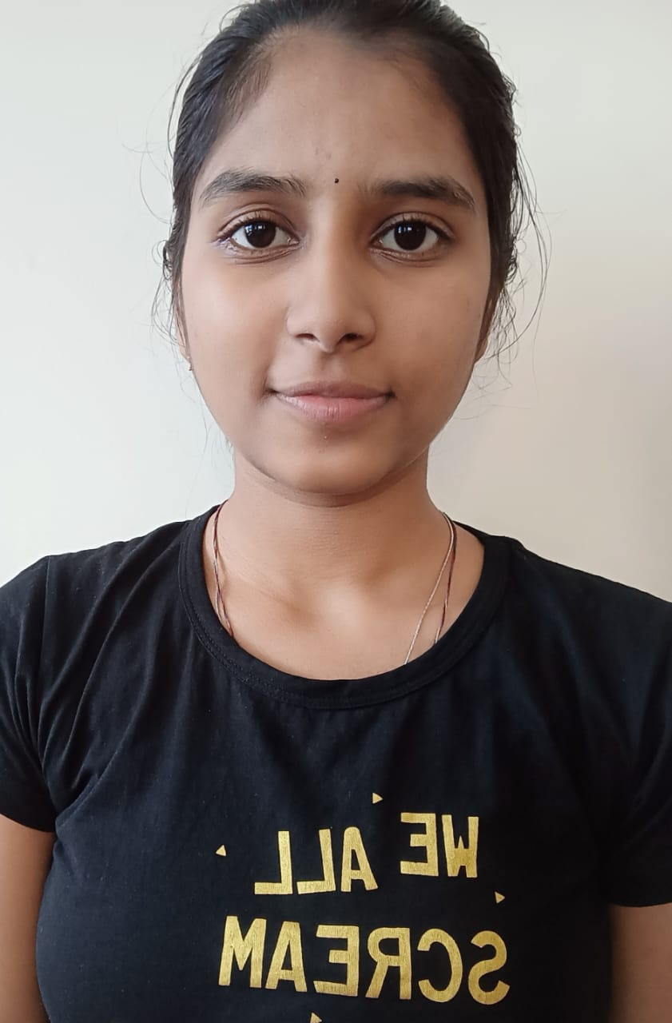
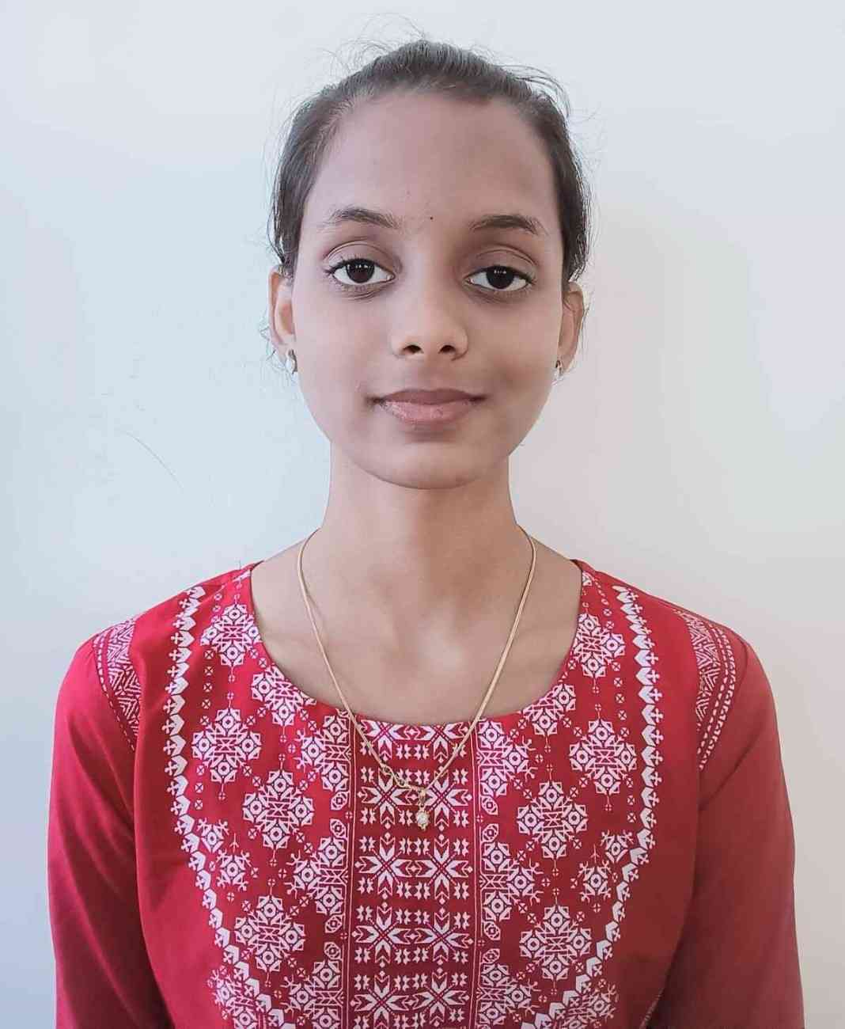
Name of the team: Team CoreCoders
Details of Team members
TEAM MEMBER NAME | Recent Passport Photo | Email ID | Phone number [WhatsApp]
Manasa K B |  | manasakb111@gmail.com | +91 7483635211
Nandini |  | Nandini2005reddy@gmail.com | +91 90191 75124
Chandana A J |  | chandanajiglur@gmail.com | +91 63613 72645

Slide 3
Problem statement
1. Inefficient Use of Water Resources
Traditional Irrigation Practices
Most farmers follow fixed irrigation schedules or intuition-based decisions without considering real-time soil moisture or crop water requirements, leading to significant water wastage and inefficient resource utilization.
2. Lack of Real-Time Irrigation Intelligence
Limited Visibility into Soil and Weather Dynamics
Farmers do not have continuous, integrated insights into soil moisture levels, evapotranspiration rates, rainfall variability, and crop growth stages, making it difficult to adjust irrigation decisions dynamically.
3. Absence of Early Water Stress Detection
Reactive Rather Than Proactive Irrigation Management
Existing systems detect irrigation issues only after crop stress or yield loss has occurred, due to the absence of intelligent analysis that identifies early signs of under-irrigation or over-irrigation.
4. Need for Explainable and Assistive Decision Support
Limited Adoption of Intelligent Irrigation Systems
Current automated or data-driven solutions often operate as black boxes or directly control irrigation systems, reducing farmer trust and highlighting the need for an explainable, assistive AI system that supports—rather than replaces—human decision-making.

Slide 4
Proposed solution
Analyze real-time soil moisture and weather data to understand current irrigation conditions.
Use agentic AI to detect early under-irrigation and over-irrigation risks.
Incorporate crop type and growth stage for accurate water requirement assessment.
Generate explainable, guideline-based irrigation advisories using AI and RAG.
Provide assistive decision support without automating irrigation control systems.

Slide 5
Need of project
To reduce water wastage caused by inefficient irrigation practices.
To help farmers understand real-time soil moisture and weather conditions.
To detect irrigation problems early before crop stress occurs.
To support sustainable and water-efficient farming practices.
To assist farmers with data-driven irrigation decisions without replacing human control.

Slide 6
End user of project
Farmers and farm owners
Agricultural extension officers
Precision agriculture service providers
Irrigation planners and water resource managers
Government and agricultural policy departments

Slide 7
Technology Used
Web Browser (Chrome) – Accessed LangFlow and IBM watsonx.ai cloud services
IBM watsonx.ai – Used IBM Granite model for AI reasoning and insights
IBM Granite Model (ibm-granite-3-2-8b) – Core AI model for analysis and recommendations
LangFlow – Visual tool for building and connecting AI agents
RAG (Retrieval Augmented Generation) – Used irrigation guidelines and best-practice documents
Weather / Environmental APIs – Provided real-time weather data inputs
Cloud-Based Architecture – No local hardware dependency, accessible from mobile devices

Slide 8
Novelty and Uniqueness
Focuses on early detection of irrigation inefficiencies, not post-damage analysis.
Uses a multi-agent AI approach for structured and explainable decision support.
Combines soil, weather, and crop growth data for precise irrigation insights.
Provides assistive, transparent recommendations instead of automated control.
Designed as a low-cost, mobile-accessible solution, usable even from an iPhone.

Slide 9
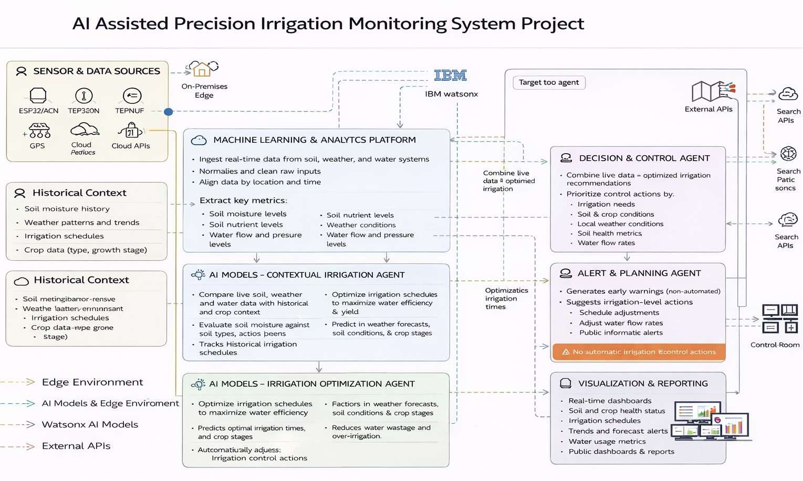
Technical flow diagram - Architecture blueprint

Slide 10
Langflow component Used
Chat Input - Accepts user queries
IBM watsonx AI Agent (Multiple Agents) -Traffic Analysis, Congestion Risk Detection, Decision, Alert & Planning ,Visualization
Search API Tool -Fetches real-time traffic, weather, and incident data
File Component (RAG / Historical Context) -Provides historical traffic patterns and guidelines
Chat Output - Displays alerts, predictions, and recommendations

Slide 11
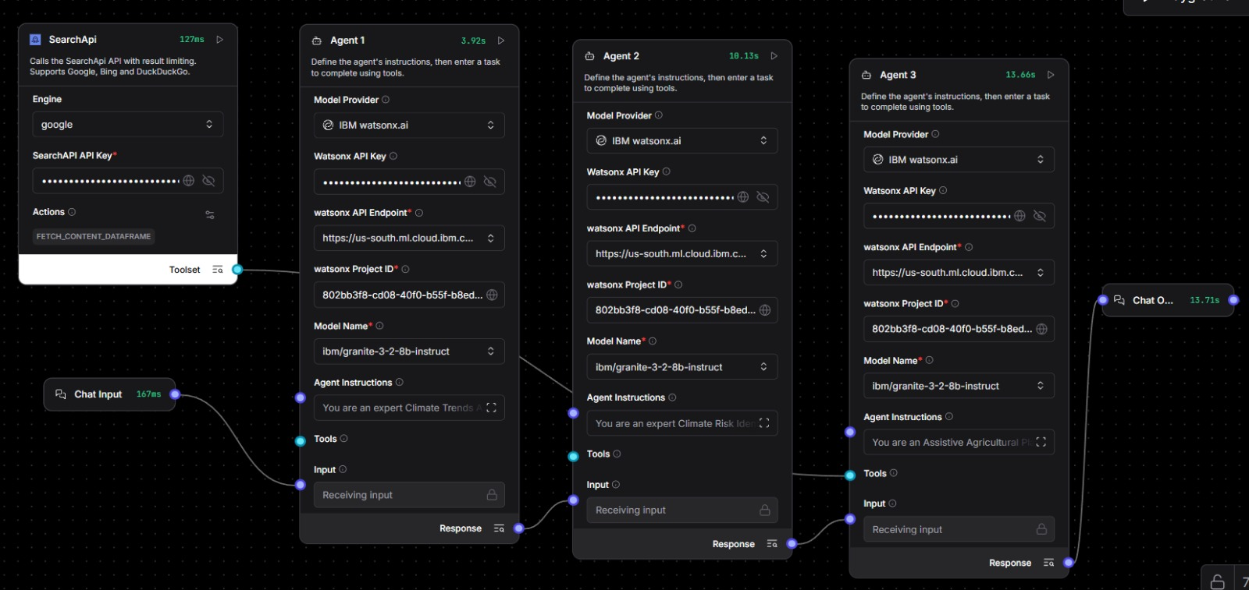
Input Screenshot 1

Slide 12
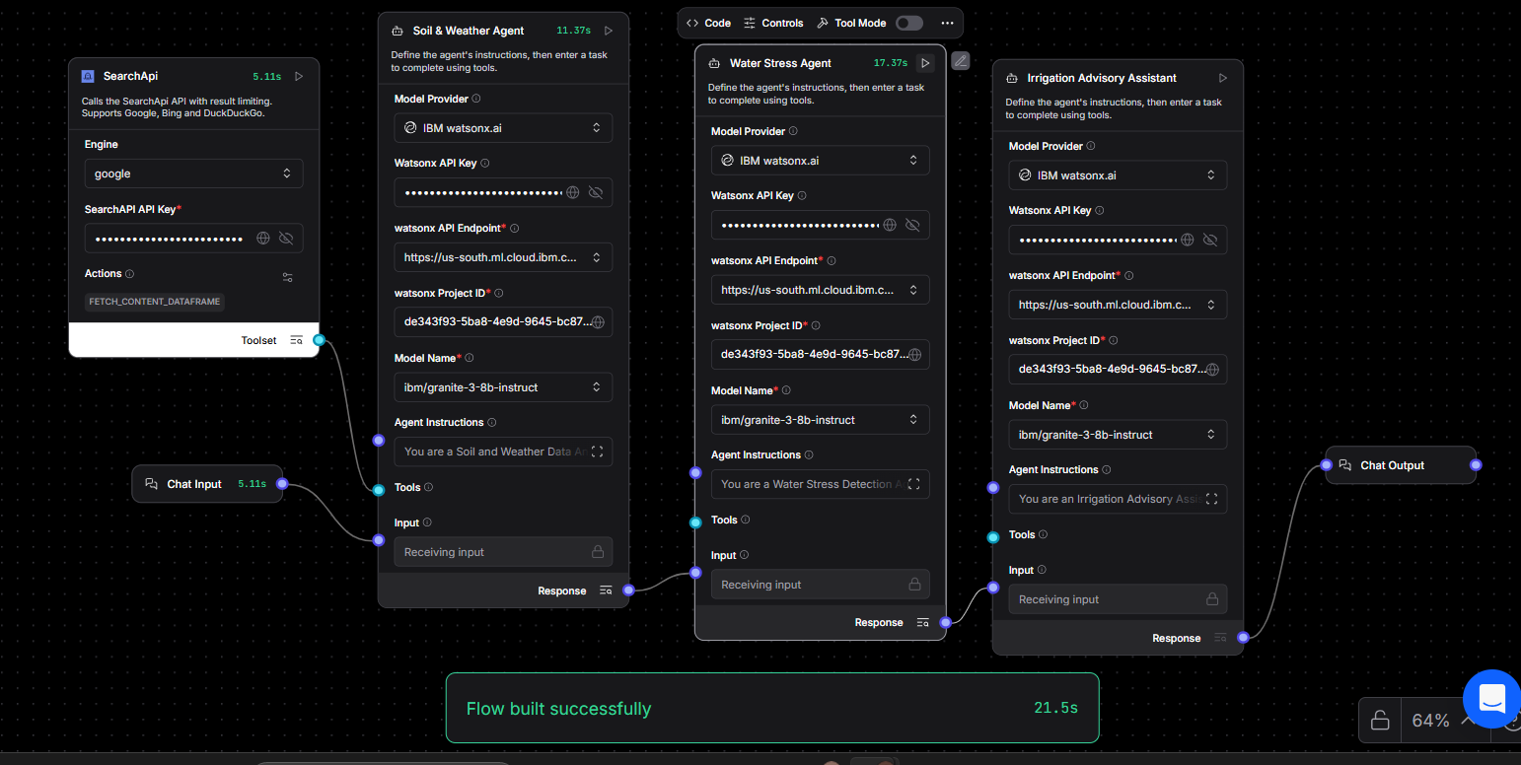
Input Screenshot 2

Slide 13
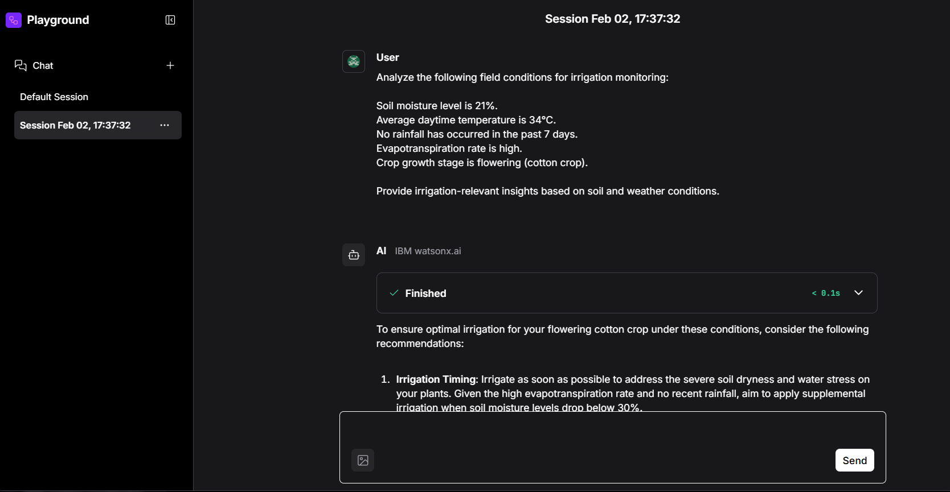
Output Screenshot 1

Slide 14
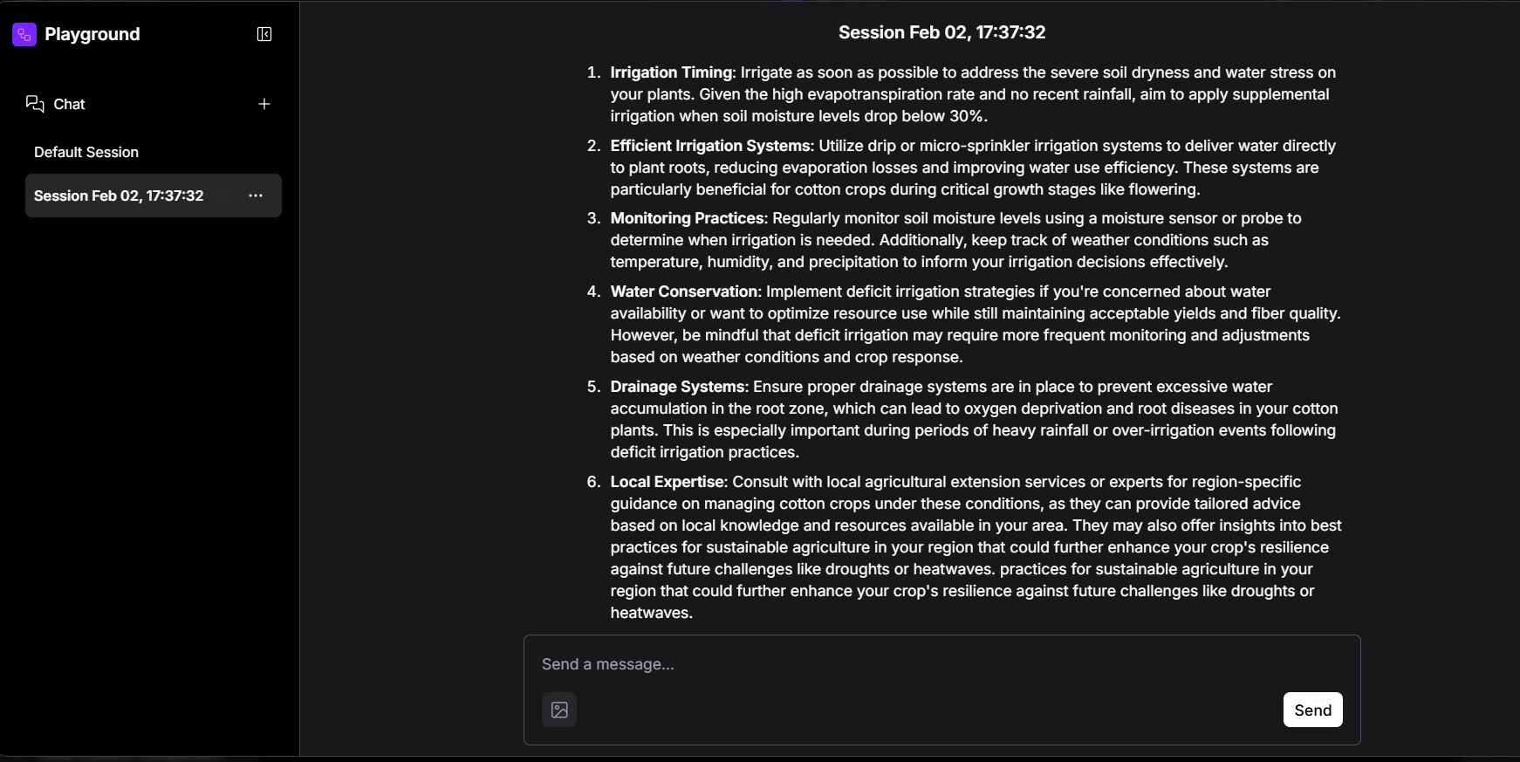
Output Screenshot 2

Slide 15
Future Scope
Integration with IoT-enabled automated irrigation systems for semi-automated watering based on recommendations.
Expansion to multiple crop types and larger nurseries for broader applicability.
Incorporation of satellite or drone imagery for improved crop health monitoring and early pest detection.
Predictive analytics for seasonal irrigation planning using historical soil, weather, and growth data.
AI-driven optimization for fertilizer and nutrient management alongside irrigation recommendations.
·

Slide 16
Git Hub Link
https://github.com/Nandini-Reddy16/ai-climate-risk-assessment-agriculture.git

Slide 17
References
IBM watsonx.ai documentation
IBM Granite foundation model documentation
IBM Watson Machine Learning (WML) API reference

Slide 18


